Slide 1
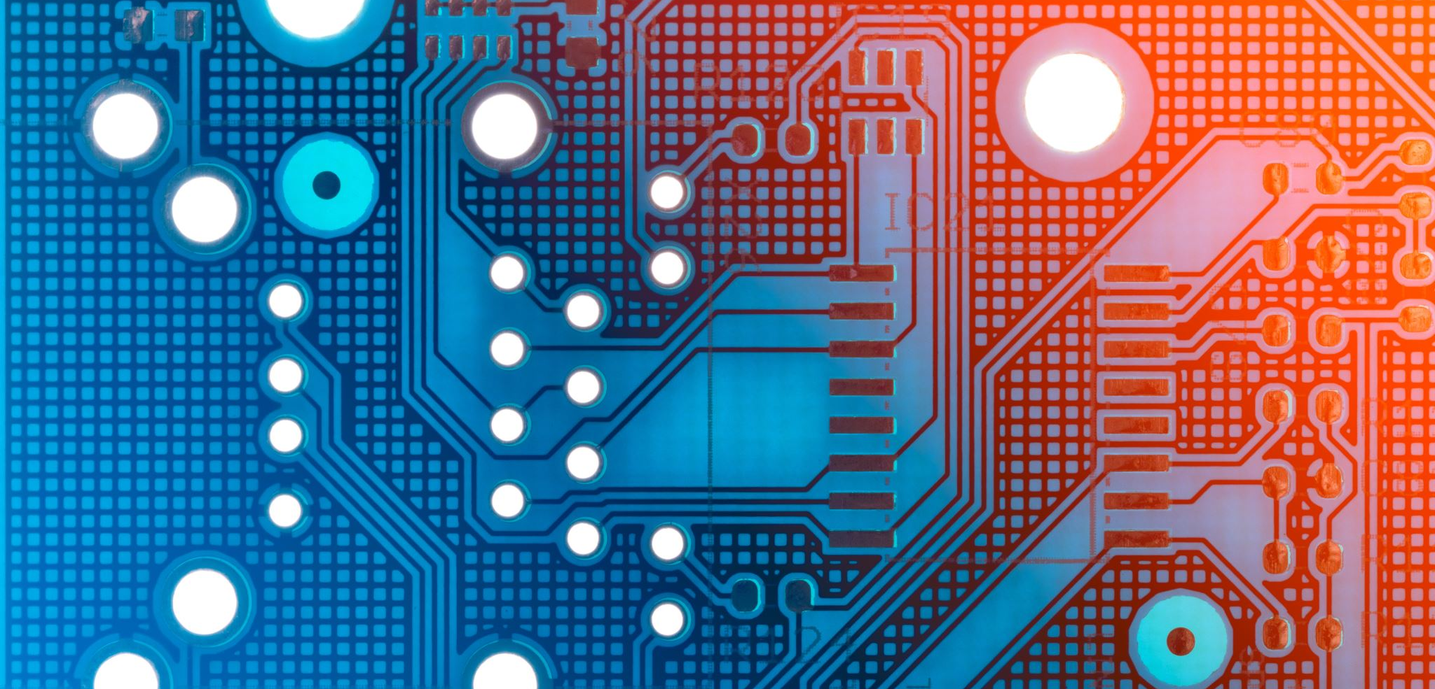
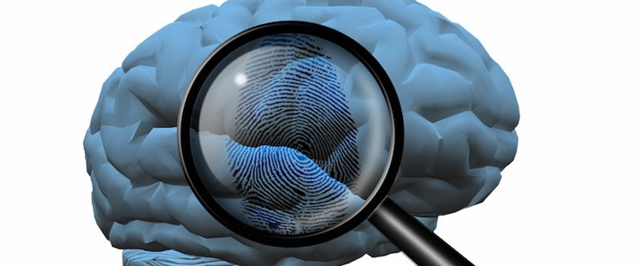
Brain Active Nano Chip
The chip for Activate your Brain next level Generation
Author:
R.KARTHICK PANDIYAN;
||| YEAR ECE;
812419106023//E1194021;
M.I.E.T ENGINEERING COLLEGE;
TIRUCHIRAPPALI DISTRICT;
This Photo by Unknown author is licensed under CC BY.

Slide 2
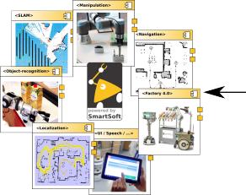
COMPONENTS
Tungsten.
Silicon.
Platinum-iridium.
Even Stainless steel.
This Photo by Unknown author is licensed under CC BY.

Slide 3
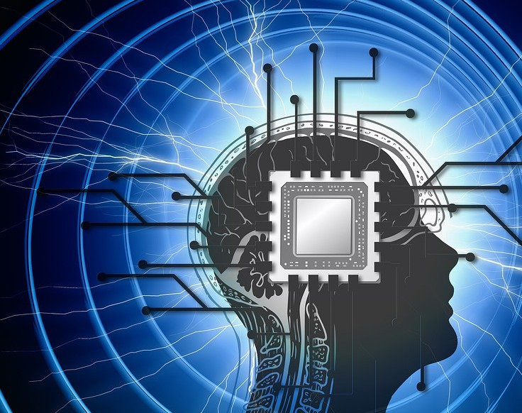
INTRODUCTION
The brain chip technology is associated with a slothful human being.
It can be used for mentally affected the human being .
Brain chip consists of both biological and electronics
terms.

Slide 4
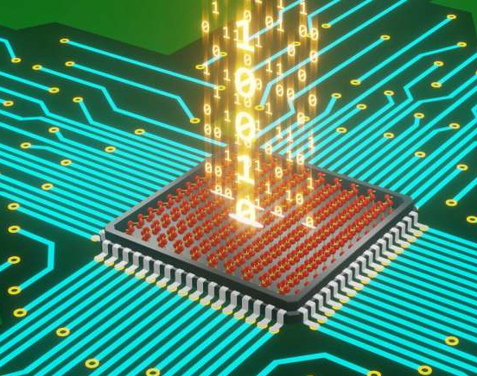
What is a brain chip ?
A chip in the brain gate is of 100 hair thin electrodes.
It senses electromagnetic of Neutrons.
It mainly required for Mentally affected human being .
This Photo by Unknown author is licensed under CC BY-SA.

Slide 5
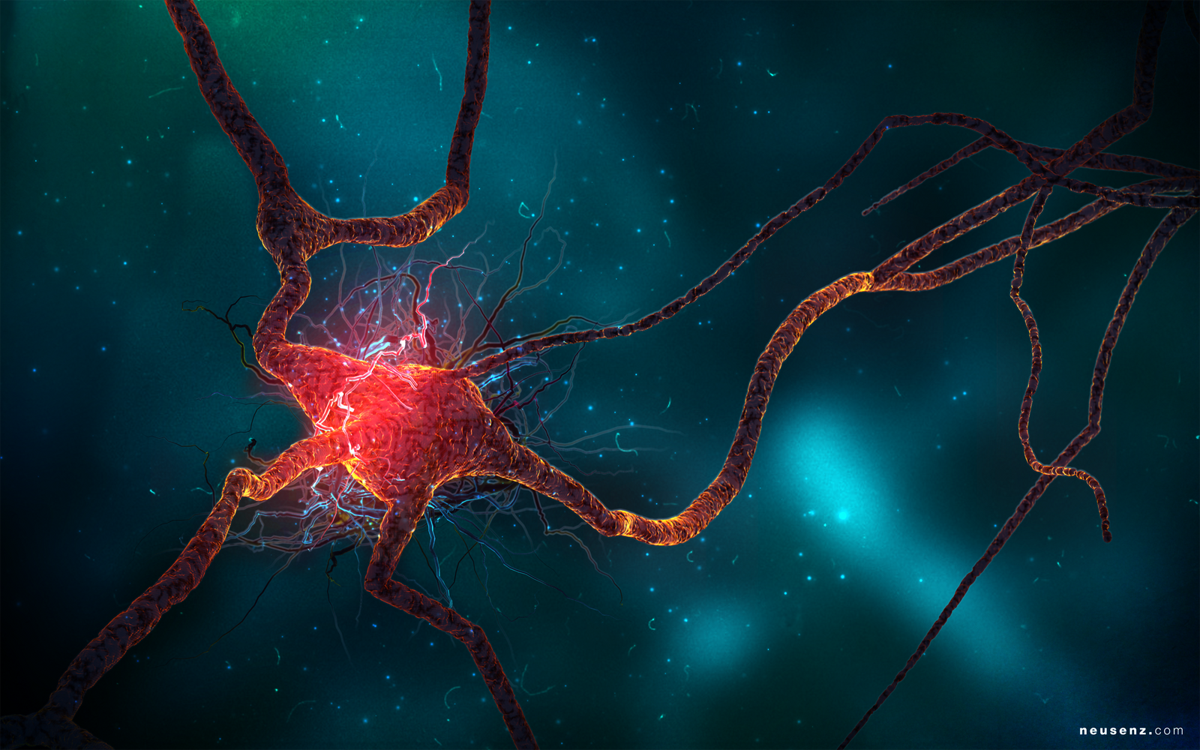
What is Neuron ?
Neurons are INFORMATION MESSENGERS.
The use Electrical impulses and chemical signals to transmit information between different areas of the brains.
The rest of the nervous system.
This Photo by Unknown author is licensed under CC BY-NC-ND.

Slide 6
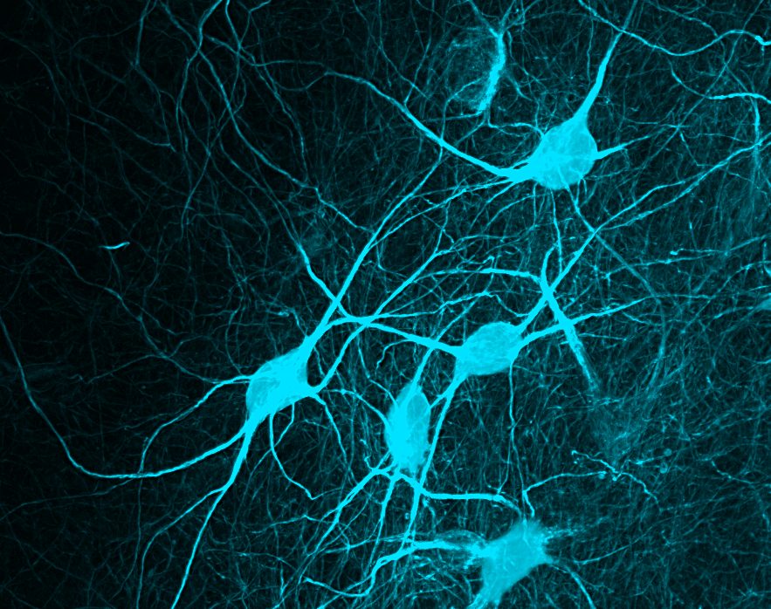
How Chip can be charged ?
In the human brain the neuron has 23 watts capacity of power.
Chip takes the power from the neuron.
Chip works by neuron.
This Photo by Unknown author is licensed under CC BY-SA-NC.

Slide 7
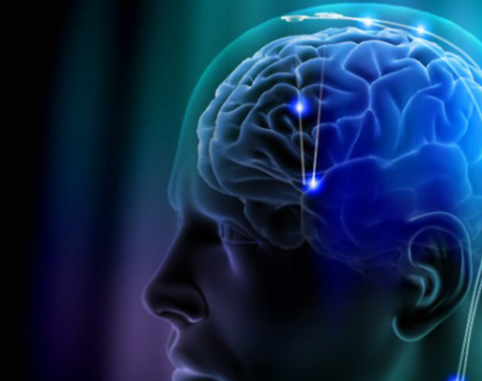
Chip function:
The chip is inset into cerebrum.
Chip takes the power from the neuron.
Slothful human brain is activate form.
The chip increases the agility of the lazy
Human brain.
This Photo by Unknown author is licensed under CC BY-NC-ND.

Slide 8
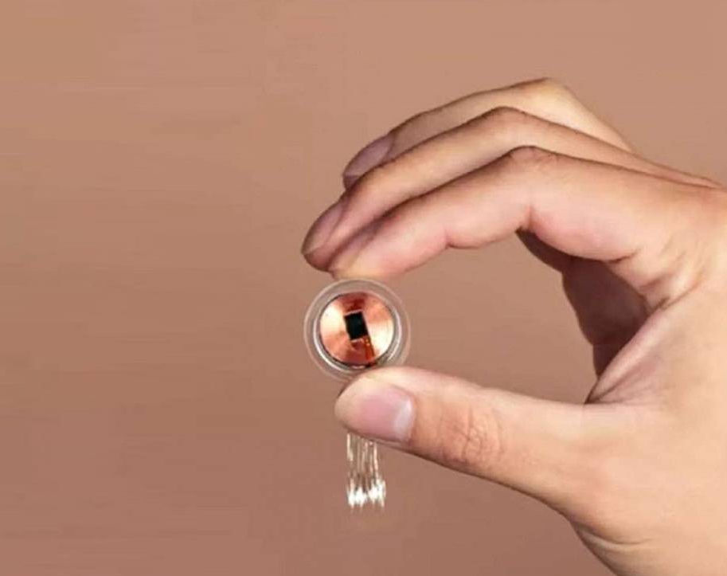
How does it look ?

Slide 9
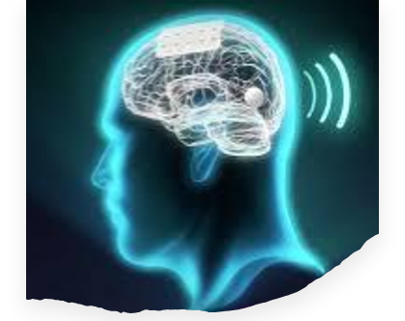
Benefits :
Thus there is a lot of opportunity to reduce bad habits in our country.
If a man thinks of perhaps harmful thoughts the chip embedded within him can immediately inform us.
Thus stopping the action of the chip fitted inside him.

Slide 10
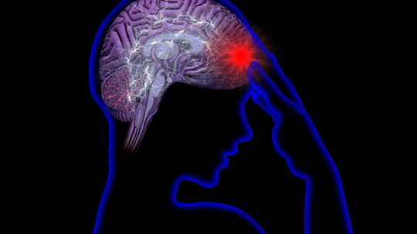
Disadvantage
Its power is likely to decrease as power is drawn from the neuron.
This Photo by Unknown author is licensed under CC BY-NC.

Slide 11
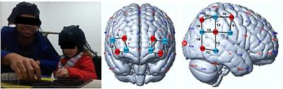
Project outcome
This Photo by Unknown author is licensed under CC BY.
The chip will keep the human brain active at all times.
As this software increases the thinking ability of human beings new innovation are likely to come.
This software helps mentally ill people to come to their senses.

Slide 12

That's my presentation

